Slide 1


Green Cloud-Oriented AI Framework for Sustainable Datacenter
Resource Scheduling and Cooling Optimization
CSA1506 - CLOUD COMPUTING AND BIG DATA ANALYTICS
Guided by :
Dr. Boomija M D
Presented by :
C.KARTHIK (192573008)
E.KHADRI NATH GOWD (192472296)
B PRAVEEN KUMAR (192511135)

Slide 2
Introduction
• Cloud computing is widely used, but datacenters consume a large amount of energy and require efficient resource management.
• AI-based resource scheduling helps improve server utilization and reduces unnecessary power consumption.
• Intelligent cooling systems minimize energy usage by adjusting cooling based on server workload and temperature.
• This project develops a Green Cloud AI framework to achieve sustainable, energy-efficient, and high-performance datacenter operations.

Slide 3
Problem statement
• Traditional resource scheduling methods lead to poor server utilization and increased energy consumption.
• Existing cooling systems consume excessive power due to the lack of intelligent temperature management.
• Conventional approaches cannot efficiently adapt to dynamic cloud workloads, reducing overall performance
• An AI-driven Green Cloud framework is needed to optimize resource allocation, cooling, and energy efficiency.

Slide 4
Objectives
Predict server workload using machine learning.
Make workload-aware resource scheduling decisions.
Optimize cooling according to server conditions.
Measure power and carbon-emission reduction.
Provide a web-based dashboard for monitoring and visualization.

Slide 5
Abstract
> This project proposes an AI-based framework for efficient resource scheduling and cooling optimization in cloud datacenters.
> The system monitors server resources and predicts workload demands using machine learning techniques.
> It intelligently allocates workloads and optimizes cooling to reduce energy consumption and operational costs.
> The proposed framework improves resource utilization, enhances performance, and supports sustainable cloud computing.

Slide 6
Literature review
Table 1
Author & Year | Title | Methodology | Findings | Research Gap
Buyya et al. (2010) | Energy-Efficient Management of Data Center Resources for Cloud Computing | Dynamic VM allocation and resource scheduling | Improved server utilization and reduced energy consumption through efficient resource management. | Did not consider AI-based cooling optimization and sustainability together.
HUNTER Framework (2021) | AI-Based Holistic Resource Management for Sustainable Cloud Computing | AI-driven workload scheduling and resource optimization | Achieved better energy efficiency, thermal management, and Quality of Service (QoS). | Computational complexity is high, and scalability remains a challenge for large cloud data centers.
Lin et al. (2024) | Green-Aware Management Techniques for Sustainable Data Centers | Systematic review of green cloud scheduling and cooling techniques | Highlighted the importance of integrating AI, renewable energy, and intelligent cooling to reduce carbon emissions. | Identified the need for a unified AI framework that jointly optimizes resource scheduling and cooling systems.

Slide 7
MODULES
1) Resource Monitoring and Data Collection
2) AI-Based Resource Scheduling
3) Cooling and Energy Optimisation

Slide 8
Resource Monitoring and Data Collection
Module 1
Datacenter parameters are collected for each server, including CPU usage, memory usage, network usage, temperature, and power consumption.
Server workload information is recorded as Low, Medium, or High to represent the operating condition of the datacenter.
The collected dataset is preprocessed by encoding categorical values and standardizing numerical features before AI-based analysis.
The processed information is used as the input for workload prediction, resource scheduling, cooling optimization, and sustainability analysis.

Slide 9
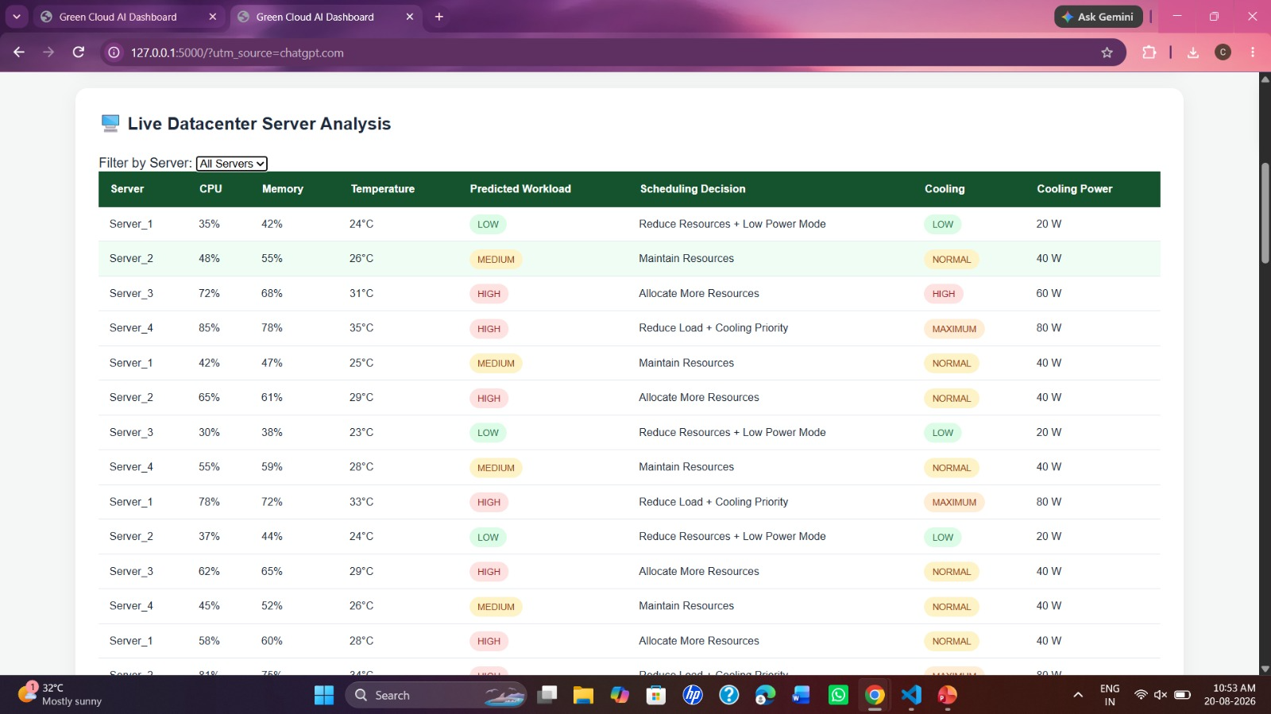
OUTPUT

Slide 10
AI-Based Resource Scheduling
Module 2
• Cloud computing is widely used, but datacenters consume a large amount of energy and require efficient resource management.
• AI-based resource scheduling helps improve server utilization and reduces unnecessary power consumption.
• I ntelligent cooling systems minimize energy usage by adjusting cooling based on server workload and temperature.
• This project develops a Green Cloud AI framework to achieve sustainable, energy-efficient, and high-performance datacenter operations.

Slide 11
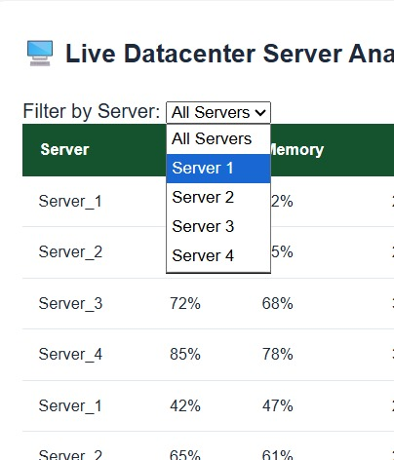
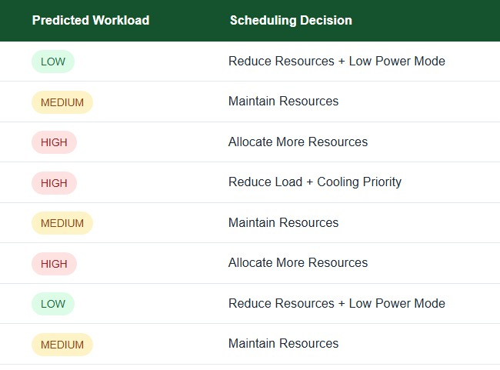
OUTPUT

Slide 12
Cooling and Energy Optimisation
Module 3
Cooling requirements are determined from server temperature and predicted workload, allowing different cooling levels to be assigned to different operating conditions.
The framework uses Low, Normal, High, and Maximum cooling levels, with corresponding cooling power requirements of 20 W, 40 W, 60 W, and 80 W.
The optimized configuration reduces average power consumption from 219.90 W in the conventional case to 204.90 W using the Green AI approach.
The resulting energy reduction is 6.82%, while the calculated carbon reduction is 0.0060 kg CO₂/hour.

Slide 13

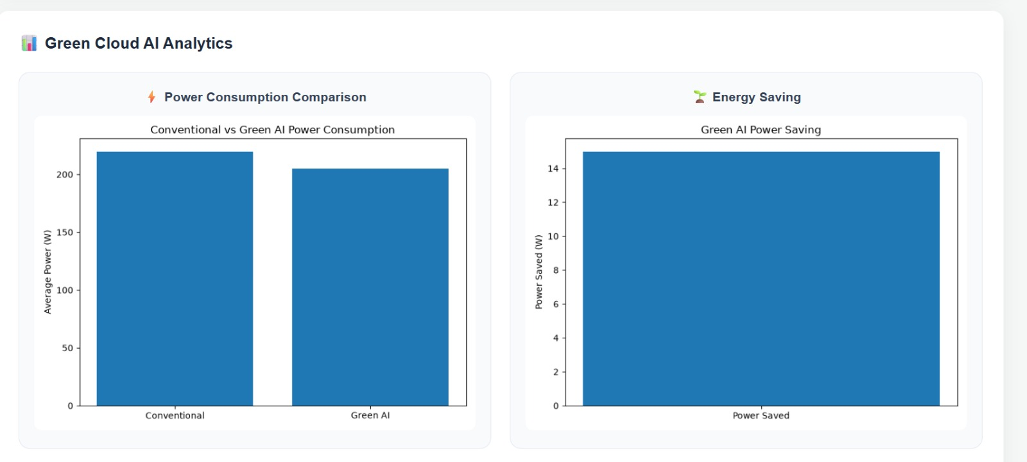
OUTPUT

Slide 14
Conculsion
Existing studies have improved data center performance through energy-efficient resource scheduling and AI-based workload management.
Intelligent cooling techniques help reduce energy consumption but are often implemented separately from resource scheduling.
Intelligent cooling techniques help reduce energy consumption but are often implemented separately from resource scheduling.
The proposed Green Cloud-Oriented AI Framework for Sustainable Datacenter Resource Scheduling and Cooling Optimization addresses this gap by enhancing energy efficiency, reducing carbon emissions, and improving overall data center sustainability.

Slide 15
Thank you

